Slide 1
Framing a Geo Strategy for the Web with Points-Of-Interest Data
at: Terra Cognita
by: Raj Singh, PhD
Director, Interoperability Programs
Open Geospatial Consortium
12 November 2012

Slide 2
Notes:
in the geo world we’ve created lots of great stuff, but it’s largely inaccessible to the larger world. To make an analogy, we’ve only provided rough, arid dirt rock-filled roads to our geodata, and expect everyone to be driving a ruggedized jeep to get to it. Our “stuff” isn’t used, then we ask why everyone isn’t driving off-road vehicles, instead of making our roads better.

Slide 3
What are OpenPOIs?
http://openpoidb.ogcnetwork.net
A registry of all the places in the world, and links to all the web resources with information about those places 9 ½ million places to date
query API: space, name, time formats: XML, JSON, microdata or RDF
A location resource that’s always current, accurate, and authoritative
OpenPOIs is evolving into the single most comprehensive, structured registry of points of interest on the Web.

Slide 4
OpenPOIs Registry
http://openpoi.ogcnetwork.net
a living laboratory for connecting the web to the geo web
reference implementation of the POI format
open: data, code, platform
provides a Rosetta Stone for all POIs, any time, anywhere
includes:
NGA, USGS, GeoNames
DBPedia
China Historical GIS
future work:
OpenStreetMap
Facebook, LinkedIn, foursquare, freebase
governments, historians
self-service synchronization

Slide 5
what is a POI?
location: geography specifier
label: name
description: narrative text
category: tags, keywords, etc.
link: related items
time: when the POI exists in the world
influences: OpenStreetMap; Atom Publishing Protocol; GeoNames
almost any geodata can be expressed as a POI

Slide 6
Location Properties
point,
line,
or polygon:
and/or address
and/or spatial relationship to another POI
</a> a geo:SpatialObject .
</a> dcterms:spatial </a/location#p> .
</a/location#p> [
</p/point#x> [
ogc:geometry ogc:point ;
dcterms:type "centroid" ;
geo:lat “42.35085” ;
geo:long “-71.06995” ;
] .
] .

Slide 7
Descriptive Property: category
category
term: the unique identifier – aka tag (mandatory)
scheme: URI identifier for the term’s definition. may be resolvable (optional)
value: human-readable description (optional)
href: URL to full definition. always resolvable (optional)
type: MIME type of the href (optional)
XML examples:
<category term="722110" scheme="http://www.census.gov/naics/2007/" type="text/html"
href="http://www.census.gov/econ/industry/def/d722110.htm">Full-service restaurants</category>
<category term="rating:food" scheme="http://www.example.com/category/ratings"
href="http://www.example.com/ratings/food#extraordinary_to_perfection">27</category>
<category term="cuisine" scheme="http://www.example.com/category/cuisines"
href="http://www.example.com/ratings/cuisines">Deli</category>

Slide 8
Descriptive Property: link
link
term: relationship of link to the POI (mandatory)
href: URL for linked content (mandatory)
type: MIME type of href (mandatory)
value: human-readable description (optional)
author: basic attribution (optional)
XML examples:
<link term="related" href="http://en.wikipedia.org/wiki/Faneuil_Hall" type="text/html"/>
<link term="related" href="http://www.cityofboston.gov/freedomtrail/faneuilhall.asp"
type="text/html"/>
<link term="related" href="http://www.thefreedomtrail.org/visitor/faneuil-hall.html"
type="text/html"/>
<link term="related" href="http://www.faneuilhallmarketplace.com/" type="text/html"/>
<link term="image”
href="http://www.cityofboston.gov/Images_Documents/Bright_Fan_Hall_tcm3-2661.gif"
type="image/gif"/>
<link term="related" href="http://hdl.loc.gov/loc.award/mhsalad.130006">
<value>Faneuil Hall, exterior: perspective view, Boston, MA</value>
<author term="LOC" href="http://www.loc.gov" type="text/plain">
<value>Library of Congress</value>
</author>
</link>

Slide 9
Data Management Properties (metadata)
id: unique identifier for the POI in the publisher’s system
created/updated/deleted: applies to the POI record (not the actual place in the world—time property covers that)
license: use restrictions, e.g. copyright

Slide 10
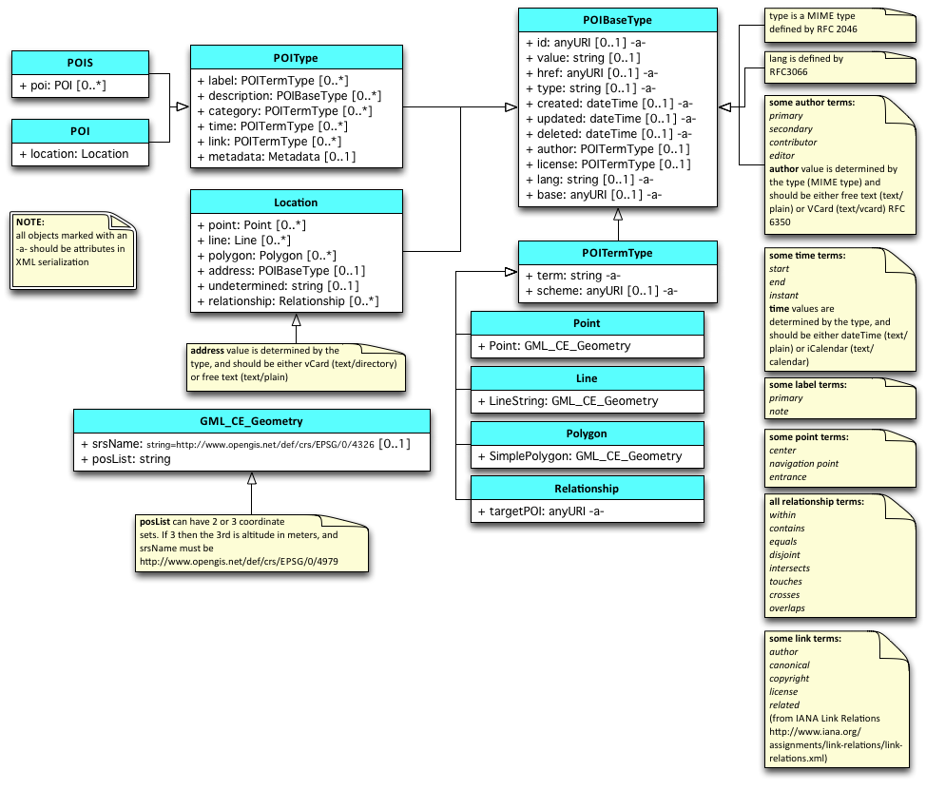
Data Model
http://www.w3.org/2010/POI/wiki/Data_Model

Slide 11
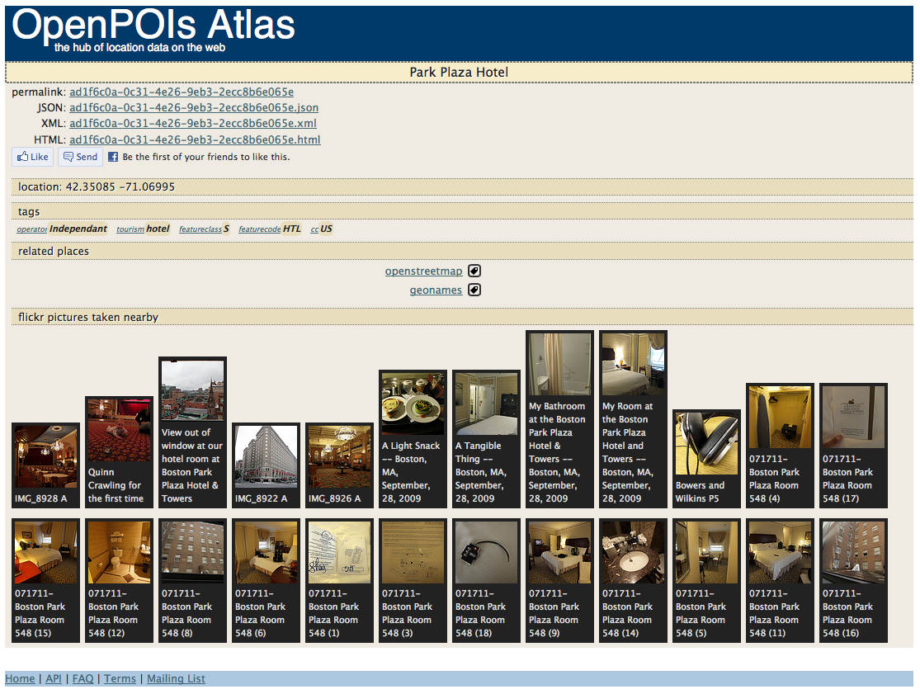
Park Plaza Hotel: HTML

Slide 12
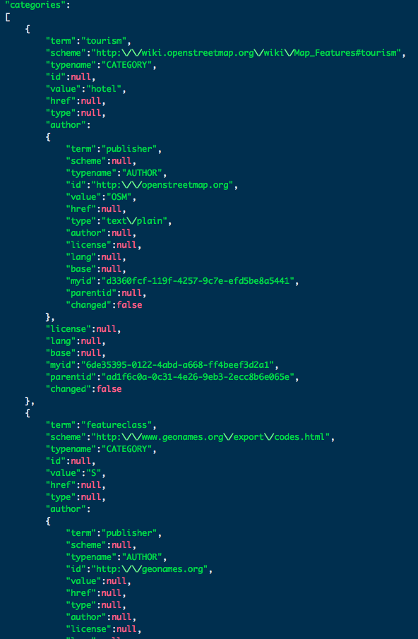
Park Plaza Hotel: JSON

Slide 13
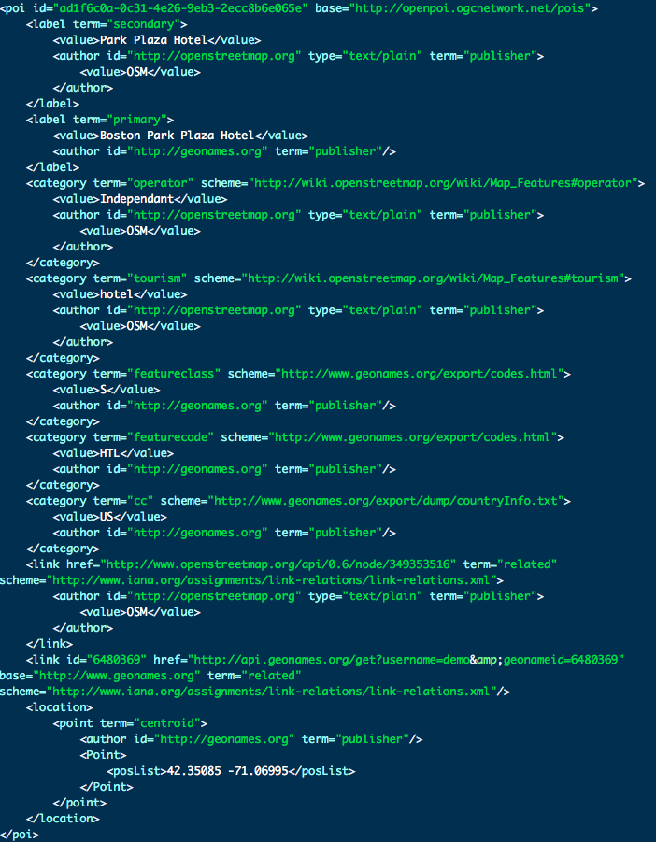
Park Plaza Hotel: XML

Slide 14
poi
+ label: POITermType
+ description: POIBaseType
+ category: POITermType
+ time: POITermType
+ link: POITermType
+ metadata: Metadata
+ location: Location
location
+ point: Point
+ line: Line
+ polygon: Polygon
+ address: POIBaseType
+ undetermined: string
+ relationship: Relationship

Slide 15
poibasetype
+ id: anyURI
+ value: string
+ href: anyURI
+ type: string
+ created: dateTime
+ updated: dateTime
+ deleted: dateTime
+ author: POITermType
+ license: POITermType
+ lang: string
+ base: anyURI

Slide 16
poitermtype
+ term: string
+ scheme: anyURI
poibasetype
+ id: anyURI
+ value: string
+ href: anyURI
+ type: string
+ created: dateTime
+ updated: dateTime
+ deleted: dateTime
+ author: POITermType
+ license: POITermType
+ lang: string
+ base: anyURI

Slide 17
point
+ Point: GML_CE_GEOMETRY
poitermtype
+ term: string
+ scheme: anyURI
poibasetype
+ id: anyURI
+ value: string
+ href: anyURI
+ type: string
+ created: dateTime
+ updated: dateTime
+ deleted: dateTime
+ author: POITermType
+ license: POITermType
+ lang: string
+ base: anyURI

Slide 18
poitermtype
+ term: string
+ scheme: anyURI
label
+ term: string
+ scheme: anyURI
category
+ term: string
+ scheme: anyURI
link
+ term: string
+ scheme: anyURI
poibasetype
+ id: anyURI
+ value: string
+ href: anyURI
+ type: string
+ created: dateTime
+ updated: dateTime
+ deleted: dateTime
+ author: POITermType
+ license: POITermType
+ lang: string
+ base: anyURI
poibasetype
+ id: anyURI
+ value: string
+ href: anyURI
+ type: string
+ created: dateTime
+ updated: dateTime
+ deleted: dateTime
+ author: POITermType
+ license: POITermType
+ lang: string
+ base: anyURI
poibasetype
+ id: anyURI
+ value: string
+ href: anyURI
+ type: string
+ created: dateTime
+ updated: dateTime
+ deleted: dateTime
+ author: POITermType
+ license: POITermType
+ lang: string
+ base: anyURI
poibasetype
+ id: anyURI
+ value: string
+ href: anyURI
+ type: string
+ created: dateTime
+ updated: dateTime
+ deleted: dateTime
+ author: POITermType
+ license: POITermType
+ lang: string
+ base: anyURI
Notes:
basically, the semantic meaning of a property might change depending upon what type of object it is a part of
what’s the semantic meaning of a label’s value vs. a category’s value?
what’s the semantic meaning of a link’s term vs. a category’s term?
for a link, the term is

Slide 19
semantic concepts
poi
+ label
+ description
+ category
+ time
+ link
+ metadata
+ location
label
+ term: dcterms:type
+ scheme: dcterms:conformsTo
category
+ term: dcterms:type
+ scheme: dcterms:conformsTo
link
+ term: dcterms:type
+ scheme: dcterms:conformsTo
poibasetype
+ id: rdfs:about
+ value: dcterms:title
+ href: rdfs:isDefinedBy
+ type: dcterms:format
+ created: dcterms:created
+ updated: dcterms:modified
+ deleted: openpoi:deleted
+ author: Class
+ license: Class
+ lang: @...
+ base: @prefix
poibasetype
+ id: rdfs:about
+ value: rdf:value
+ href: rdfs:isDefinedBy
+ type: dcterms:format
+ created: dcterms:created
+ updated: dcterms:modified
+ deleted: openpoi:deleted
+ author: Class
+ license: Class
+ lang: @...
+ base: @prefix
poibasetype
+ id: rdfs:about
+ value: rdf:value
+ href: rdfs:isDefinedBy
+ type: dcterms:format
+ created: dcterms:created
+ updated: dcterms:modified
+ deleted: openpoi:deleted
+ author: Class
+ license: Class
+ lang: @...
+ base: @prefix
Notes:
basically, the semantic meaning of a property changes depending upon what type of object it is a part of
what’s the semantic meaning of a label’s value vs. a category’s value?
what’s the semantic meaning of a link’s term vs. a category’s term?
for a link, the term describes the relationship of the linked-to resource to this resource
for a category, the term describeds the “machine name” for the category (while the value is the human-readable name)
((and the scheme is the controlled vocabulary from which the term comes))

Slide 20
OpenPOIs API
query by… | example…
ID | http://openpoi.ogcnetwork.net/poiquery.php? id=adc77fe6-5ad3-4d83-b109-5cb44eb62267&format=application/json
RESTful ID | http://openpoi.ogcnetwork.net/pois/adc77fe6-5ad3-4d83-b109-5cb44eb62267.xml
radius/point | http://openpoi.ogcnetwork.net/poiquery.php?lat=42.349433712876&lon=-71.040894451933&maxfeatures=9&format=application/xml
bounding box | http://openpoi.ogcnetwork.net/poiquery.php?bbox=-71.10,42.35,-71.00,42.45&maxfeatures=20
http://openpoi.ogcnetwork.net/api.html

Slide 21
References
OpenPOI Repository: http://openpoidb.ogcnetwork.net
POI Global Interest Group: https://lists.opengeospatial.org/mailman/listinfo/openpois-users
OpenPOI Repository mailing list signup: https://lists.opengeospatial.org/mailman/listinfo/openpoidb-announce
W3C Places Community Group: http://www.w3.org/community/places/
GML 3.3: http://www.opengeospatial.org/standards/gml

